Slide 1

Intelligent Urban Mobility Analytics Using GPS and Traffic Data​
BATCH NO – 07
Team members
2420030066 - P.Likhith Sai
2420030225 - Sanivarapu Sadhana
2420030336 - M.Pavani Sree
2420030780 - B.Sai Bharghav Reddy

Slide 2

Methodology
1. Data Collection
Collected Traffic, Weather, Accident, and GPS datasets from publicly available sources.
Gathered data related to urban mobility, transportation, weather conditions, and road accidents.
Stored the datasets in structured formats such as Excel and CSV.
Used these datasets as the base input for further analysis and machine-learning prediction.
2. Data Preprocessing
Checked the datasets for missing values, empty rows, duplicates, and inconsistent data.
Removed unnecessary rows and columns that did not contribute to the analysis.
Converted required attributes into appropriate numerical/data formats.
Handled missing numerical values and prepared clean datasets for machine learning.
3. Feature Selection
Identified the features that are most relevant to the prediction task.
Removed unnecessary or irrelevant attributes from the original datasets.
Created separate selected-feature datasets for Traffic, Weather, Accident, and GPS.
Used the selected features as input variables for the Random Forest model.
4. Target Variable Preparation
Identified the target/output column that the model needs to predict.
Separated the input features (X) from the target variable (y).
Converted categorical target values into numerical labels using Label Encoding.
Ensured that the target contains appropriate classes for classification.

Slide 3
5. Machine Learning
Implemented the Random Forest Classifier for the prediction tasks.
Trained the model using the selected features from the prepared datasets.
Used multiple decision trees within Random Forest to perform classification.
Created separate prediction modules for Traffic, Weather, Accident, and GPS.
6. Model Evaluation
Evaluated the classification model using standard performance metrics.
Calculated Accuracy to measure overall correct predictions.
Calculated Precision, Recall, and F1-score to evaluate classification performance.
Used these metrics to understand how effectively the model predicts the target classes.
7. Prediction
Allowed users to enter values for the selected features through the dashboard.
Passed the entered values to the trained Random Forest model.
Generated the predicted class for Traffic, Weather, Accident, or GPS.
Displayed the prediction and, where available, the prediction confidence/probabilities.
8. Dashboard Development
Developed an interactive dashboard using Streamlit.
Created separate sections for Traffic, Weather, Accident, and GPS Prediction.
Provided input fields so users can enter feature values interactively.

Slide 4
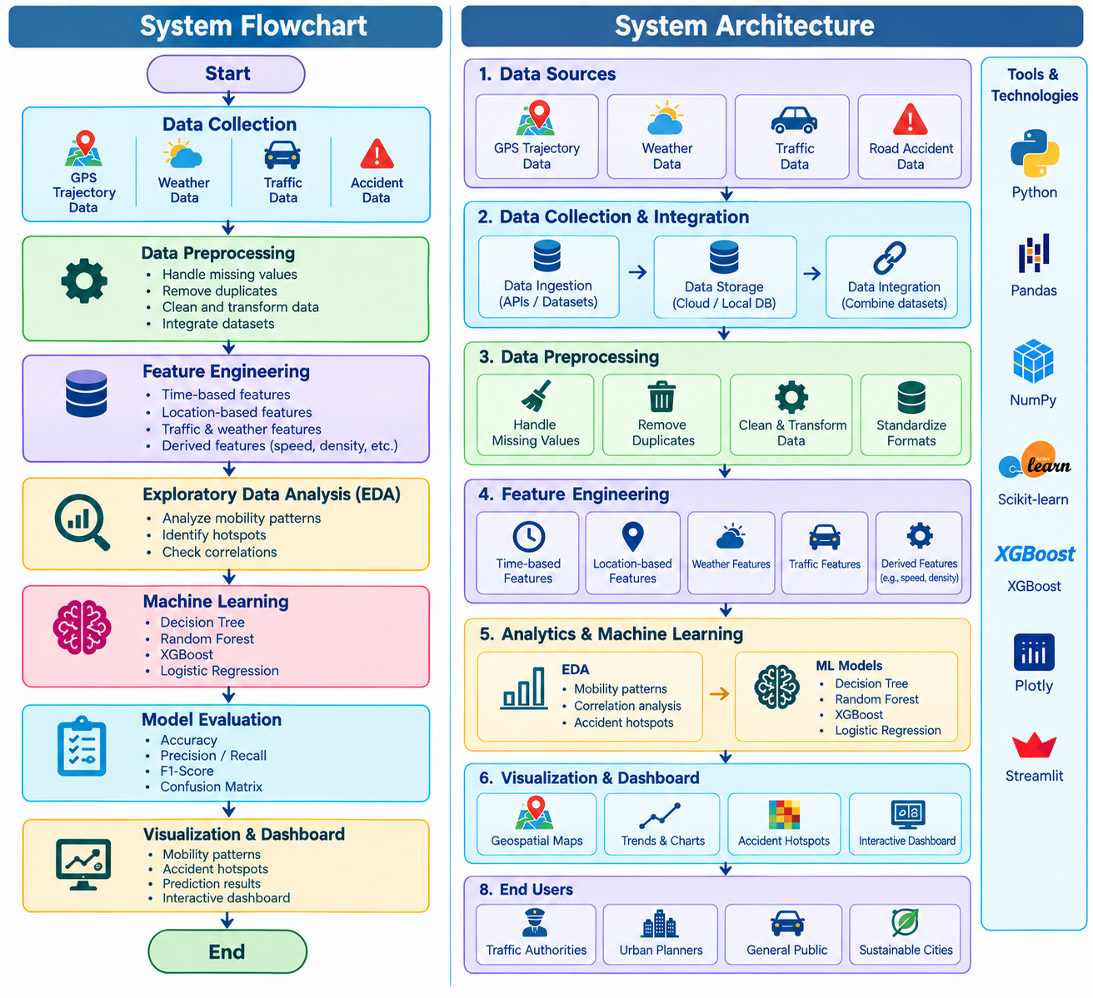
System Design

Slide 5
Modern Tools & Technologies
Category | Tool / Technology | Purpose in the Project
Programming Language | Python | Core language for data analysis, preprocessing, ML, and project implementation
Development Environment | Jupyter Notebook | Interactive data analysis, experimentation, and model development
Data Processing | Pandas | Data loading, cleaning, transformation, and analysis
Data Visualization | Matplotlib,Seaborn | Creating charts, statistical plots, correlation analysis, and heatmaps to visualize and understand traffic and mobility patterns.
Machine Learning | Scikit-learn ,XGBoost | Developing, comparing, evaluating, and improving machine learning models for accident-risk prediction.
Data Storage | CSV | Storing and managing GPS, weather, traffic, and accident datasets
Dashboard | Streamlit | Creating an interactive dashboard for mobility analysis and prediction

Slide 6
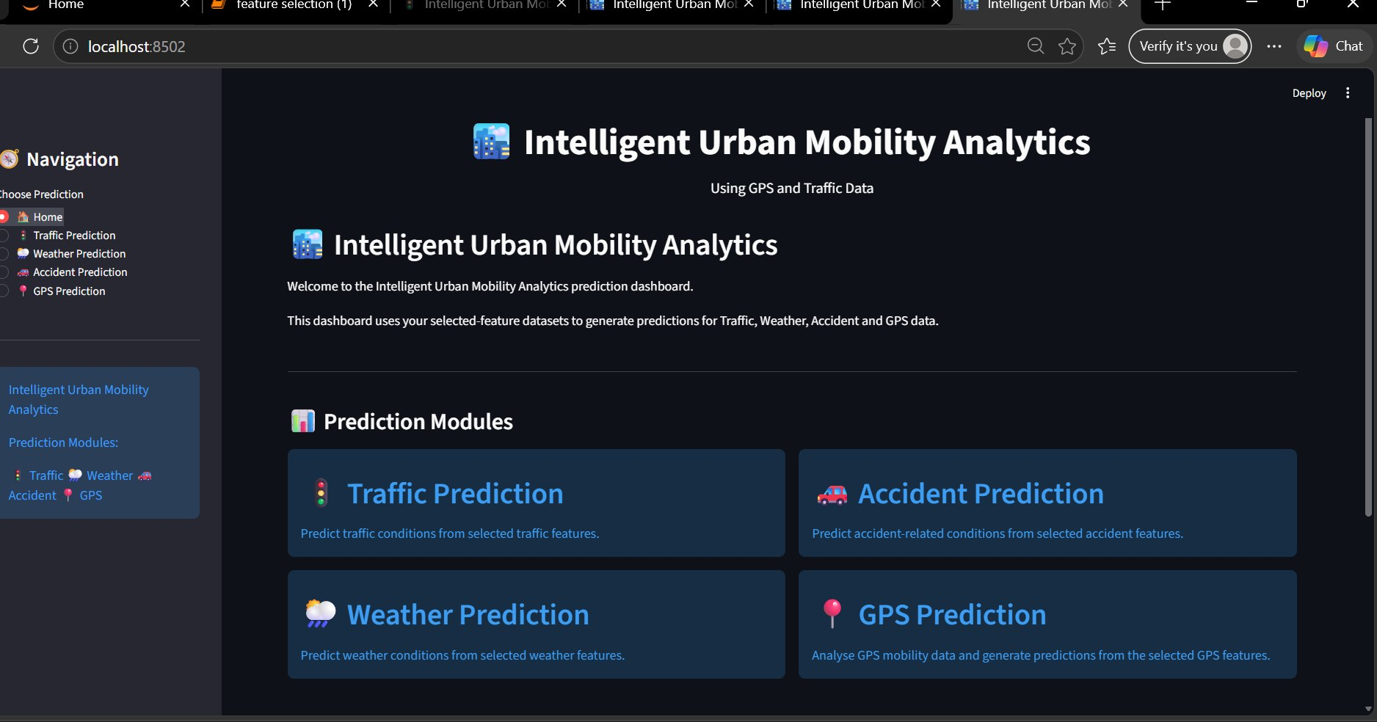
Implementation

Slide 7
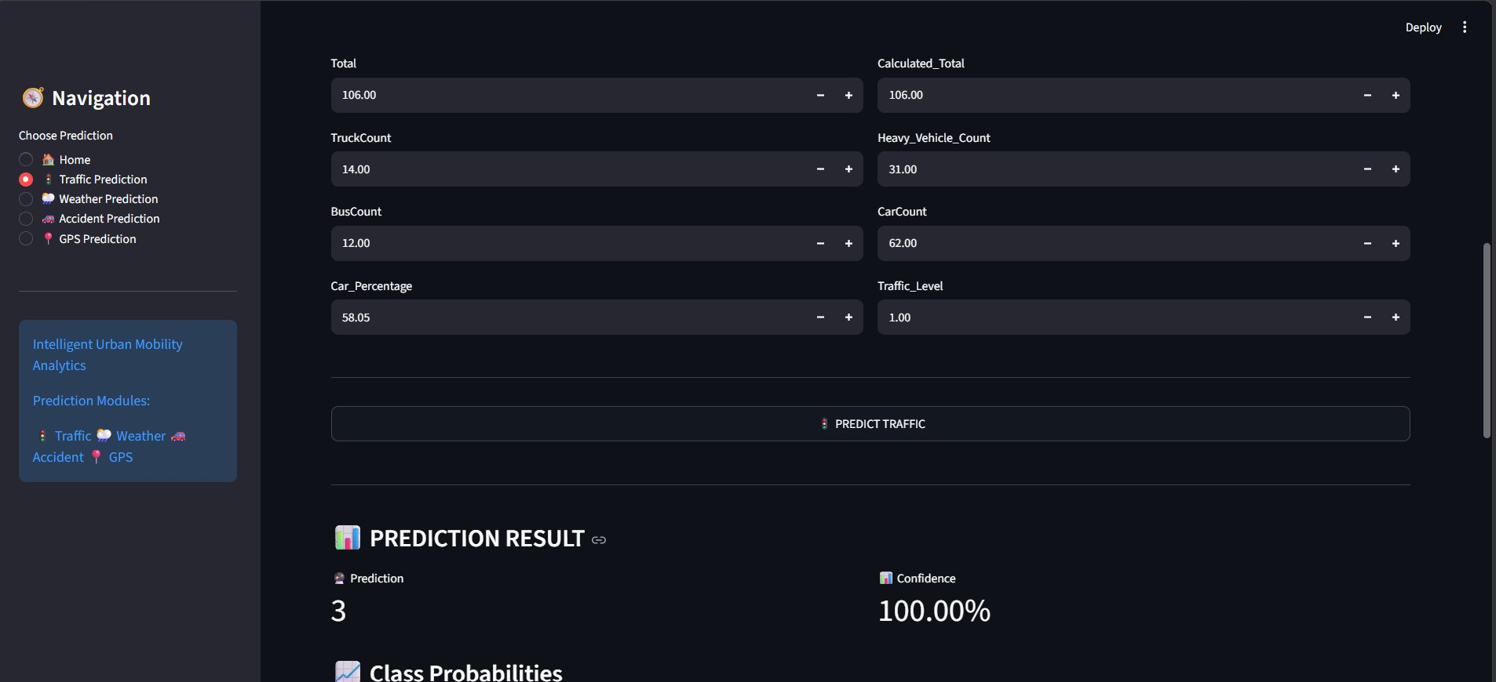

Slide 8
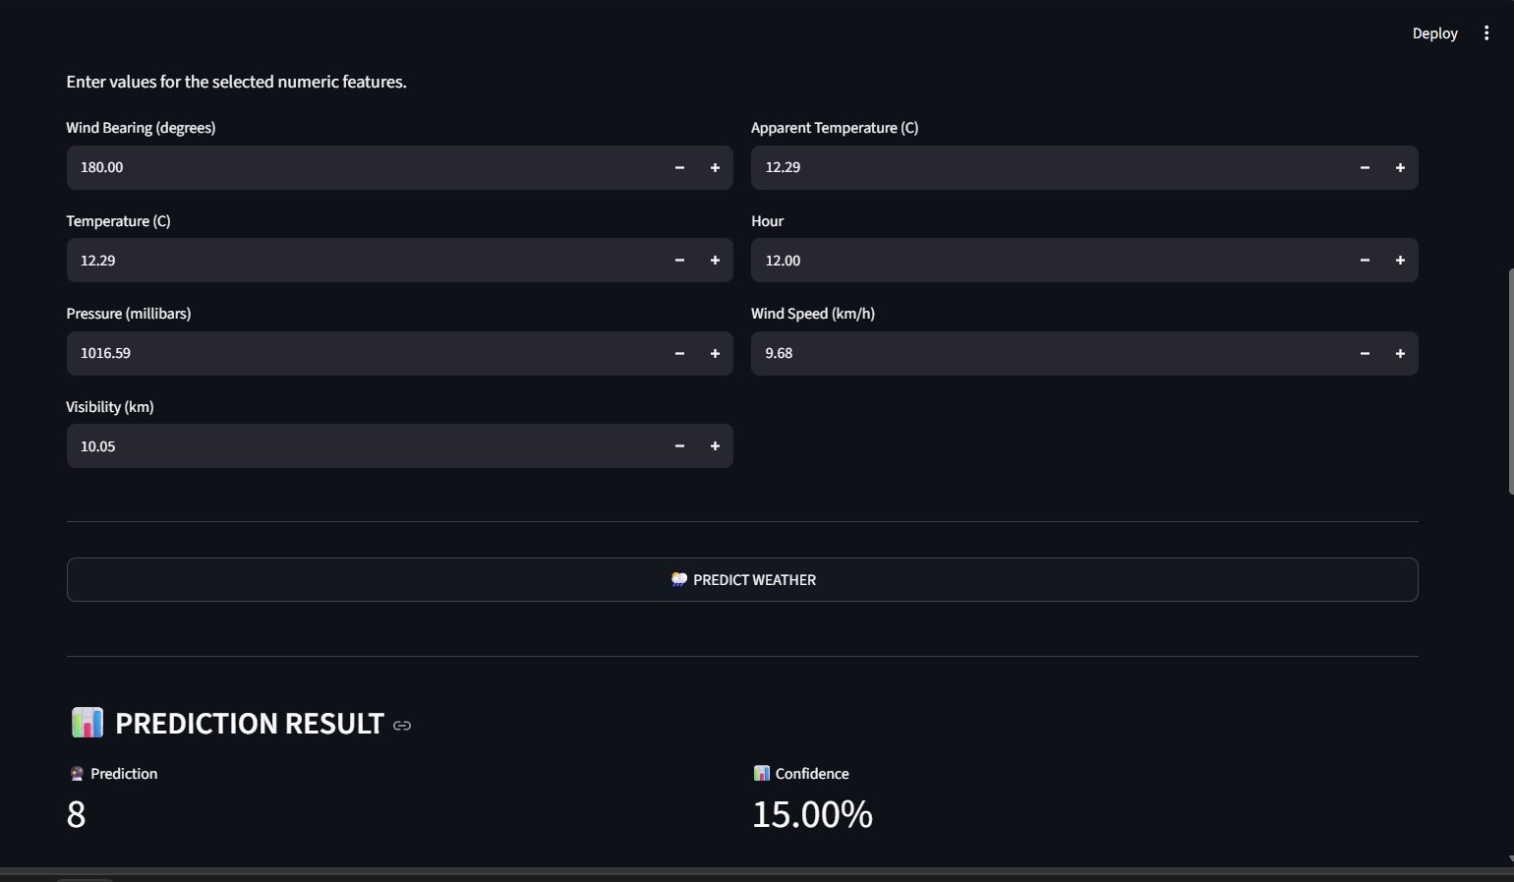

Slide 9
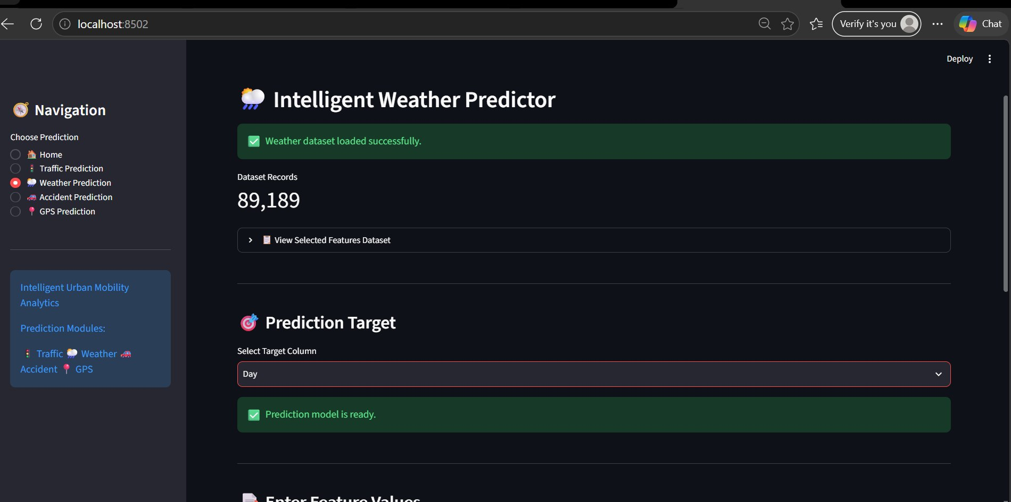

Slide 10
Results
Data Cleaning:
Cleaned GPS, weather, traffic, and accident data by handling missing and invalid records.
EDA Findings:
Identified mobility patterns, traffic conditions, accident trends, and important correlations.
Feature Engineering:
Created useful features from speed, travel time, weather, traffic, and location data.
Feature Selection:
Selected relevant features and reduced redundant data using correlation analysis.
Predictive Modeling:
Compared Decision Tree, Random Forest, XGBoost, and Logistic Regression for accident-risk prediction.
Final Outcome:
Cleaned Data → EDA → Features → ML Prediction → XAI → Dashboard

Slide 11
Performance Evaluation
Model Evaluation
Evaluated Decision Tree, Random Forest, XGBoost, and Logistic Regression models.
Evaluation Metrics
Used Accuracy, Precision, Recall, F1-Score, and ROC-AUC to measure model performance.
Model Comparison
Compared the models based on their prediction performance and reliability.
Confusion Matrix Analysis
Analysed confusion matrices to identify correct classifications and misclassified traffic conditions.
Feature Importance Analysis
Examined important traffic-related features to understand their contribution to the model's predictions.
Final Outcome:
ML Models → Performance Metrics → Model Comparison → Explainable Predictions

Slide 12
Thank you

